Slide 1
Library Management System
Project for MPP course
September 2024
Group No. 2
Marwane Bidamou
Temuulen Khuchit
Maria Luisa Lamprea

Slide 2
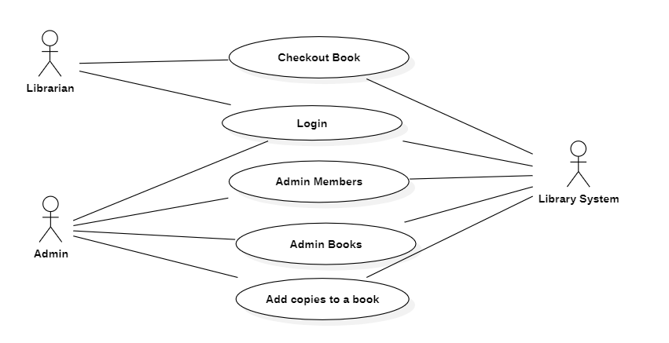
Use Case Diagram

Slide 3
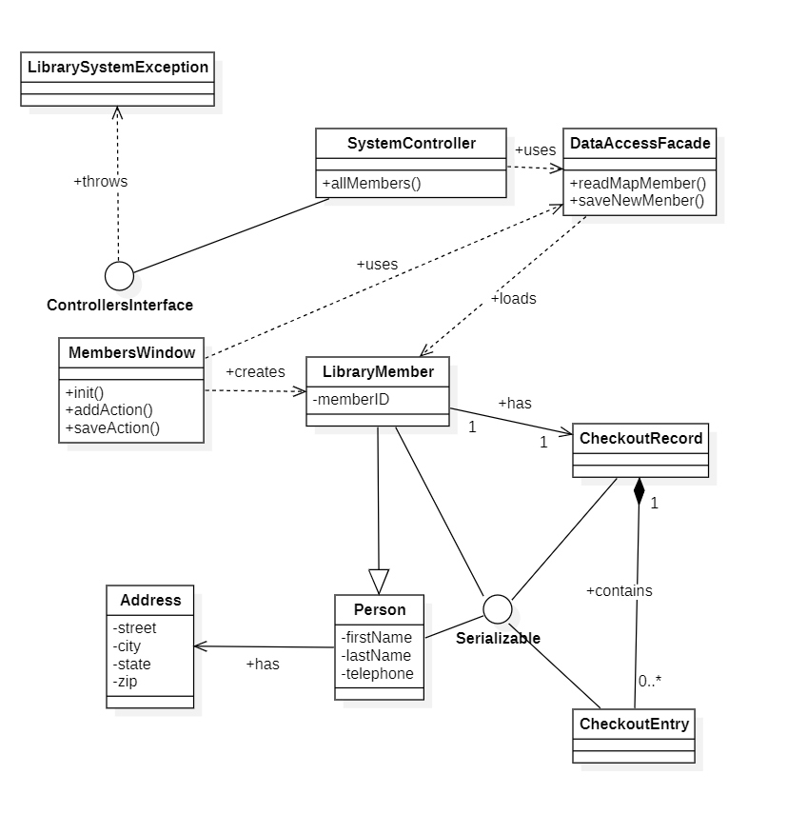
Class Model for add new Library Member use case

Slide 4
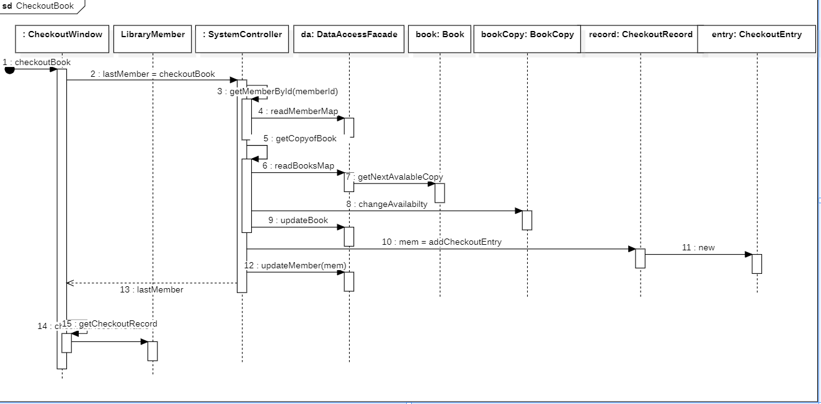
Sequence diagram for Checkout Book use case

Slide 5
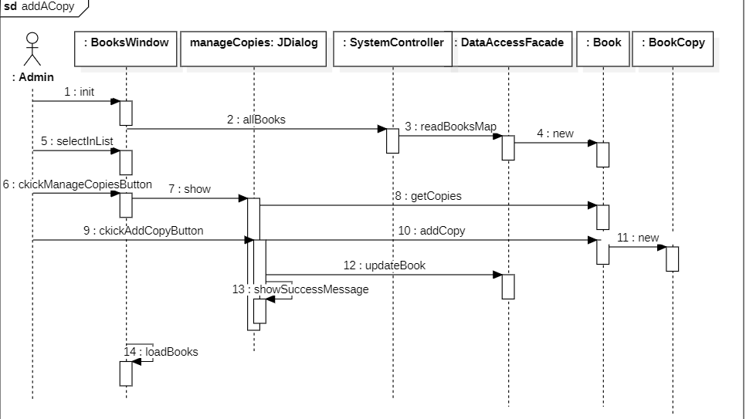
Sequence diagram for Add a Copy use case

Slide 6
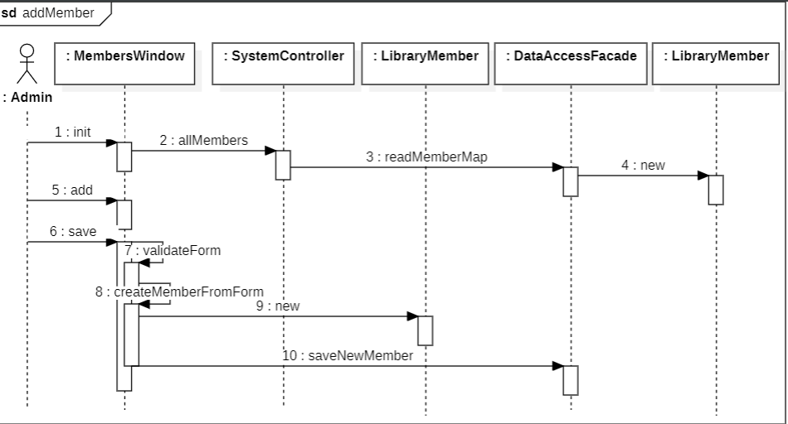
Sequence diagram for add a new Member use case

Slide 7
Discussion on Validation Rules of UI Windows (1/5)
Introduction to UI Validation:
In the Library System, validation rules ensure that all data entered is accurate and complete. This presentation covers the validation rules implemented for three key windows: BooksWindow (Books & Authors), MembersWindow, and CheckoutWindow.

Slide 8
Discussion on Validation Rules of UI Windows (2/5)
BooksWindow (Books & Authors) Validation Rules:
o ISBN Field:
Format: XX-XXXXX (e.g., 12-34567).
Uniqueness is enforced.
Error Message: "ISBN must be unique and in the format 00-00000."
o Title Field:
Cannot be empty.
rror Message: "Title cannot be empty."
o Author List:
At least one author must be added.
Error Message: "At least one author must be added."
o Author Validation:
First name and last name are required.
Telephone must follow a valid US format (e.g., 123-456-7890).
Street, city, state, and ZIP code fields are required.
ZIP code must be 5 digits.
Error Message: "Author fields cannot be left empty or incorrectly formatted."
o Checkout Period:
User must select either 7 days or 21 days.
Error Message: "Please select a checkout period (7 or 21 days)
BooksWindow Validation Flow:
When a user attempts to add or edit a book, the system validates the ISBN for uniqueness and formatting. It also verifies that the title, author list, and author details are correctly filled. Additionally, the user must select a checkout period. If any validation fails, the system displays an error message and does not save the data.

Slide 9
Discussion on Validation Rules of UI Windows (3/5)
MembersWindow Validation Rules:
o o Member ID:
Automatically generated and cannot be edited
o First Name and Last Name:
Both fields are required.
Error Message: "First name and last name cannot be empty."
o Phone Number:
Must be a valid US format: (123) 456-7890 or 123-456-7890.
Error Message: "Invalid phone number. Please enter a valid 10-digit US phone number."
o Address Fields:
Street, city, state, and ZIP code are required.
ZIP code must be 5 digits.
Error Message: "ZIP code must be a 5-digit number."
MembersWindow - Validation Flow:
In the MembersWindow, the system ensures that all fields, including name, phone number, and address, are completed. Any missing or incorrectly formatted fields trigger validation errors and prevent submission

Slide 10
Discussion on Validation Rules of UI Windows (4/5)
CheckoutWindow Validation Rules:
o Member Selection:
Must select an existing library member.
Error Message: "Please select a library member."
o Book Selection:
Must select an available book.
Error Message: "Please select a book."
o Checkout Date:
Automatically generated
o Due Date:
Calculated based on the selected book's checkout period
CheckoutWindow - Validation Flow:
In the CheckoutWindow, the user must select a valid member and book for checkout. The checkout date is automatically generated, and the due date is calculated based on the selected book’s checkout period

Slide 11
Discussion on Validation Rules of UI Windows (5/5)
Summary of Validation Rules:
The validation rules implemented across the BooksWindow,MembersWindow, and CheckoutWindow ensure that data entered is complete, accurate, and prevent invalid information from being saved. This process maintains the integrity and reliability of the library system.

Slide 12
Conclusion with STC Knowledge
This is the way that STC’s principles are related with Modern programming practices:
Inner is the bases of the outer: A well-defined object-oriented design begins by modeling the business from inside by identifying its main objects and their properties, before using them in in concrete and visible programs.
Rest and Activity are the steps of progress: the best way to achieve goals as a team is to define proper times to work, rest and personal things.
Harmony exists in diversity: in a group of three people from different continents, diversity shows three different ways of seeing the same problem, but harmony makes the final product achieves all the expectations.
The field of all possibilities is the source of all the solutions: There are many ways of solving the same problem; so, don’t be afraid of trying one new

Slide 13

Git Hub reference
https://github.com/devmarwane/library-management

